Slide 1
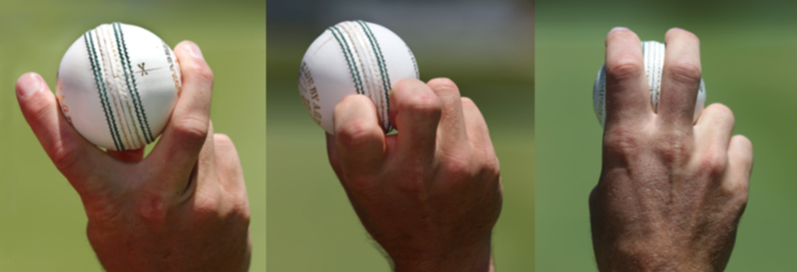


Project Title:Predicting Deceptive Bowling Deliveries in Cricket
Sanchit Kumar (2024201042)
Shivendra Pratap Singh(2024202022)
Utkarsh Sachan (2024201012)

Slide 2

Predicting Deceptive Bowling Deliveries in Cricket
This presentation explores a novel approach to predicting deceptive bowling deliveries in cricket using statistical and deep learning methods. Deceptive deliveries deviate from a bowler’s norm and can surprise batsmen, impacting match outcomes. By analyzing ball-by-ball data from the 2015 Cricket World Cup, we aim to enhance tactical planning and strategic decision-making for players and coaches.
Our approach uses an Exponentially Weighted Moving Average (EWMA) to define deception and evaluates models including Logistic Regression, Random Forest, and LSTM neural networks. We focus on temporal patterns across sequences of deliveries to improve prediction accuracy.

Slide 3
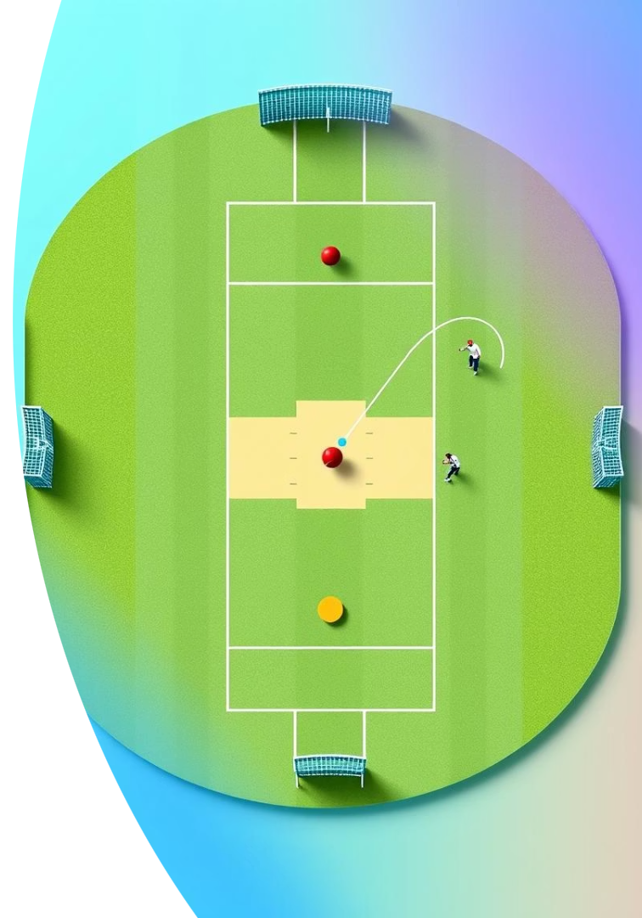
Data and Feature Engineering
Dataset
Preprocessing
25,722 deliveries from the 2015 Cricket World Cup with features like landing and ending coordinates, ball speed, and bowler type (fast, medium, spin).
Handled missing values by imputation, encoded categorical variables, and normalized features using z-scores per bowler type for consistency.
Labeling Deception
Defined deceptive deliveries as those deviating more than two standard deviations from the EWMA baseline of their bowler-type group, capturing unusual delivery patterns.

Slide 4
Model Development and Evaluation
Models Evaluated
Sequence Lengths
Logistic Regression (baseline linear model)
Models trained on sequences of 1 to 5 consecutive deliveries to capture temporal context and improve prediction of deception.
Random Forest (ensemble tree-based model)
LSTM (deep sequential neural network)

Slide 5

Initial Model Performance
Model
Accuracy
Precision
Recall
F1-Score
Logistic Regression
75.20%
0.68
0.72
0.70
Random Forest
80.35%
0.78
0.65
0.71
LSTM
84.51%
0.82
0.80
0.81
The initial LSTM model achieved the highest accuracy and balanced metrics, demonstrating the benefit of modeling temporal dependencies in delivery sequences.

Slide 6

Challenges and Model Refinements
Key Challenges
Updated LSTM Models
Insights
Class imbalance with deceptive deliveries being rare (~2%), noisy labels from thresholding, and difficulty selecting impactful features.
Increased depth, hyperparameter tuning, and class weighting were applied but led to accuracy drops (61-64%) due to overfitting and early stopping.
More complex models underfit or over-predict positives; noisy labels and premature stopping hindered training stability.

Slide 7
Interpretability and Feature Importance
Logistic Regression
Random Forest
LSTM
Top features include over number and ball speed at specific time steps, indicating temporal and contextual cues for deception.
Ball speed across recent deliveries dominates feature importance, highlighting abrupt speed changes as deception signals.
Gradient-based saliency maps show focus on early deliveries in sequences, suggesting gradual buildup of deceptive cues.

Slide 8
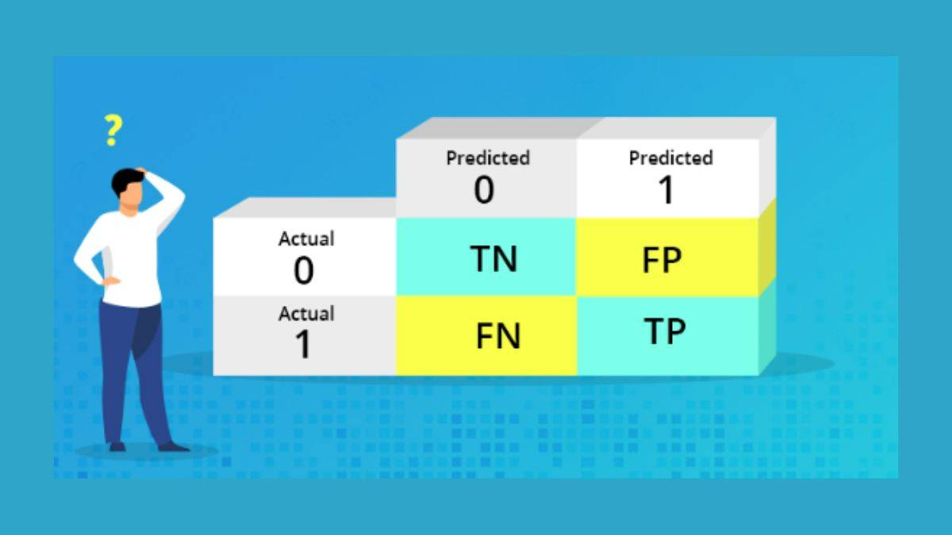
Qualitative and Confusion Matrix Analysis
LSTM Strengths
Classical Models
Detects subtle speed and line shifts by leveraging full delivery sequences, achieving high precision but low recall.
Random Forest and Logistic Regression capture categorical and over-specific cues, balancing false positives and negatives better.
Takeaway
A hybrid approach combining temporal LSTM features with classical categorical cues could improve deception detection reliability.

Slide 9
Extensions and Transfer Learning
Zero-Shot Learning
Linear Probing
Transfer Learning
LSTM embeddings generalized well to unseen bowler types, achieving 81.93% accuracy without retraining.
Refined embeddings improved class separability but plateaued at 64.95% accuracy with logistic regression.
Deception-trained embeddings adapted to boundary prediction tasks, reaching ~70% validation accuracy, showing versatility.

Slide 10
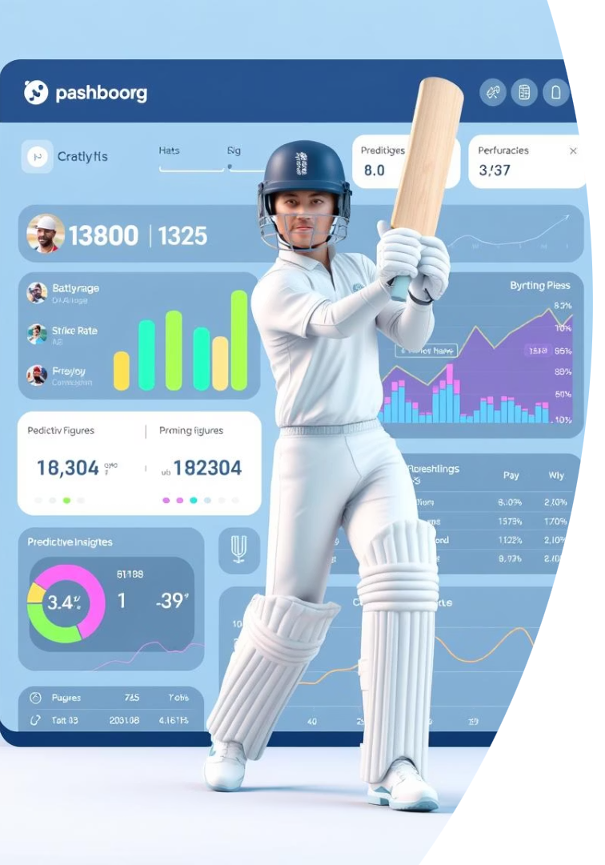
Conclusions and Future Directions
Summary
Recommendations
LSTM models outperform classical approaches by capturing temporal dependencies, but require careful tuning to handle class imbalance and noisy labels.
Use simpler models for stability, adjust class weights carefully, and increase early stopping patience. Hybrid models may enhance detection.
Future Work
Explore attention mechanisms, multimodal inputs like video, and adversarial training to improve generalization and interpretability in cricket analytics.

